Slide 1

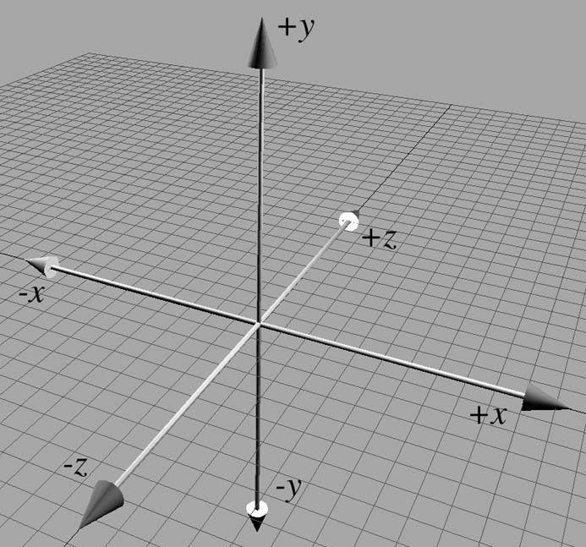
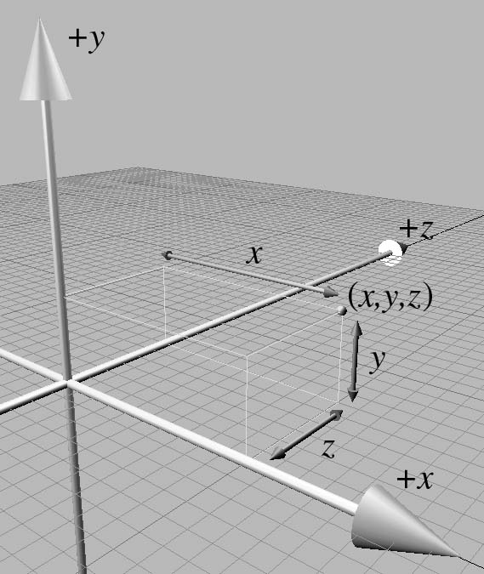
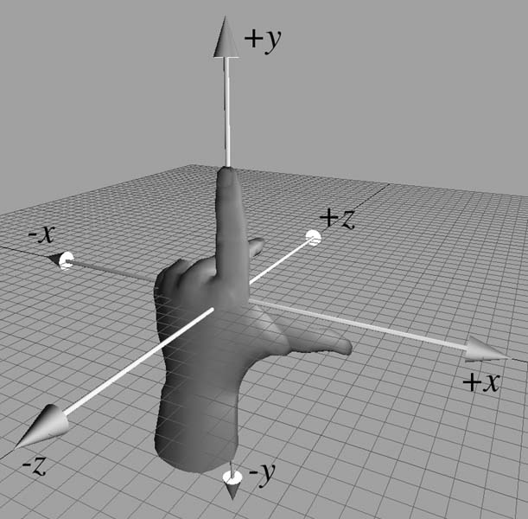
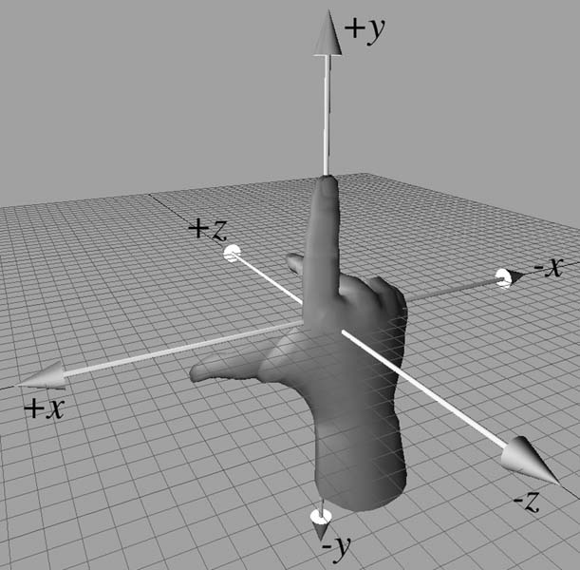
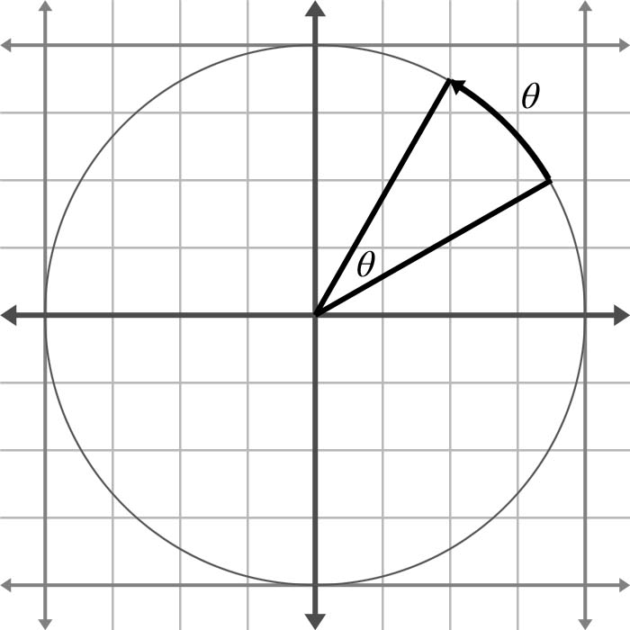
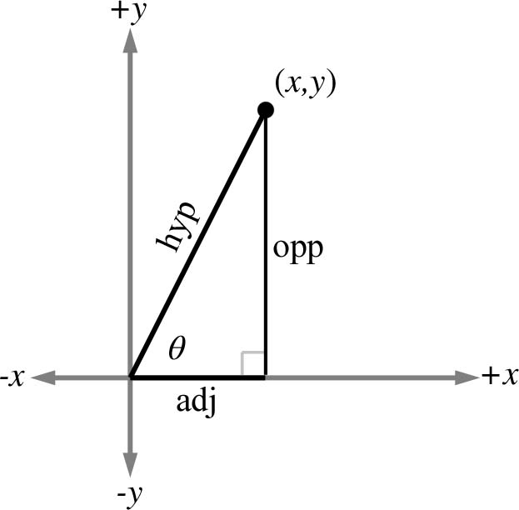
Chapter 1: Cartesian Coordinate Systems
Fletcher Dunn
Valve Software
Ian Parberry
University of North Texas
3D Math Primer for Graphics and Game Development

Slide 2
What You’ll See in This Chapter
This chapter describes the basic concepts of 3D math. It is divided into five main sections.
Section 1.1 reviews some basic principles of number systems, and The First Law of Computer Graphics. Since it is so basic, it won’t be covered in these notes.
Section 1.2 introduces 2D Cartesian mathematics, the mathematics of flat surfaces. We will learn how to describe a 2D cartesian coordinate space and how to locate points using that space.
In Section 1.3 extends these ideas into three dimensions. We will learn about left- and right-handed coordinate spaces, and establish some conventions that we will use later.
Section 1.4 covers some odds and ends of math needed for the rest of the book.

Slide 3
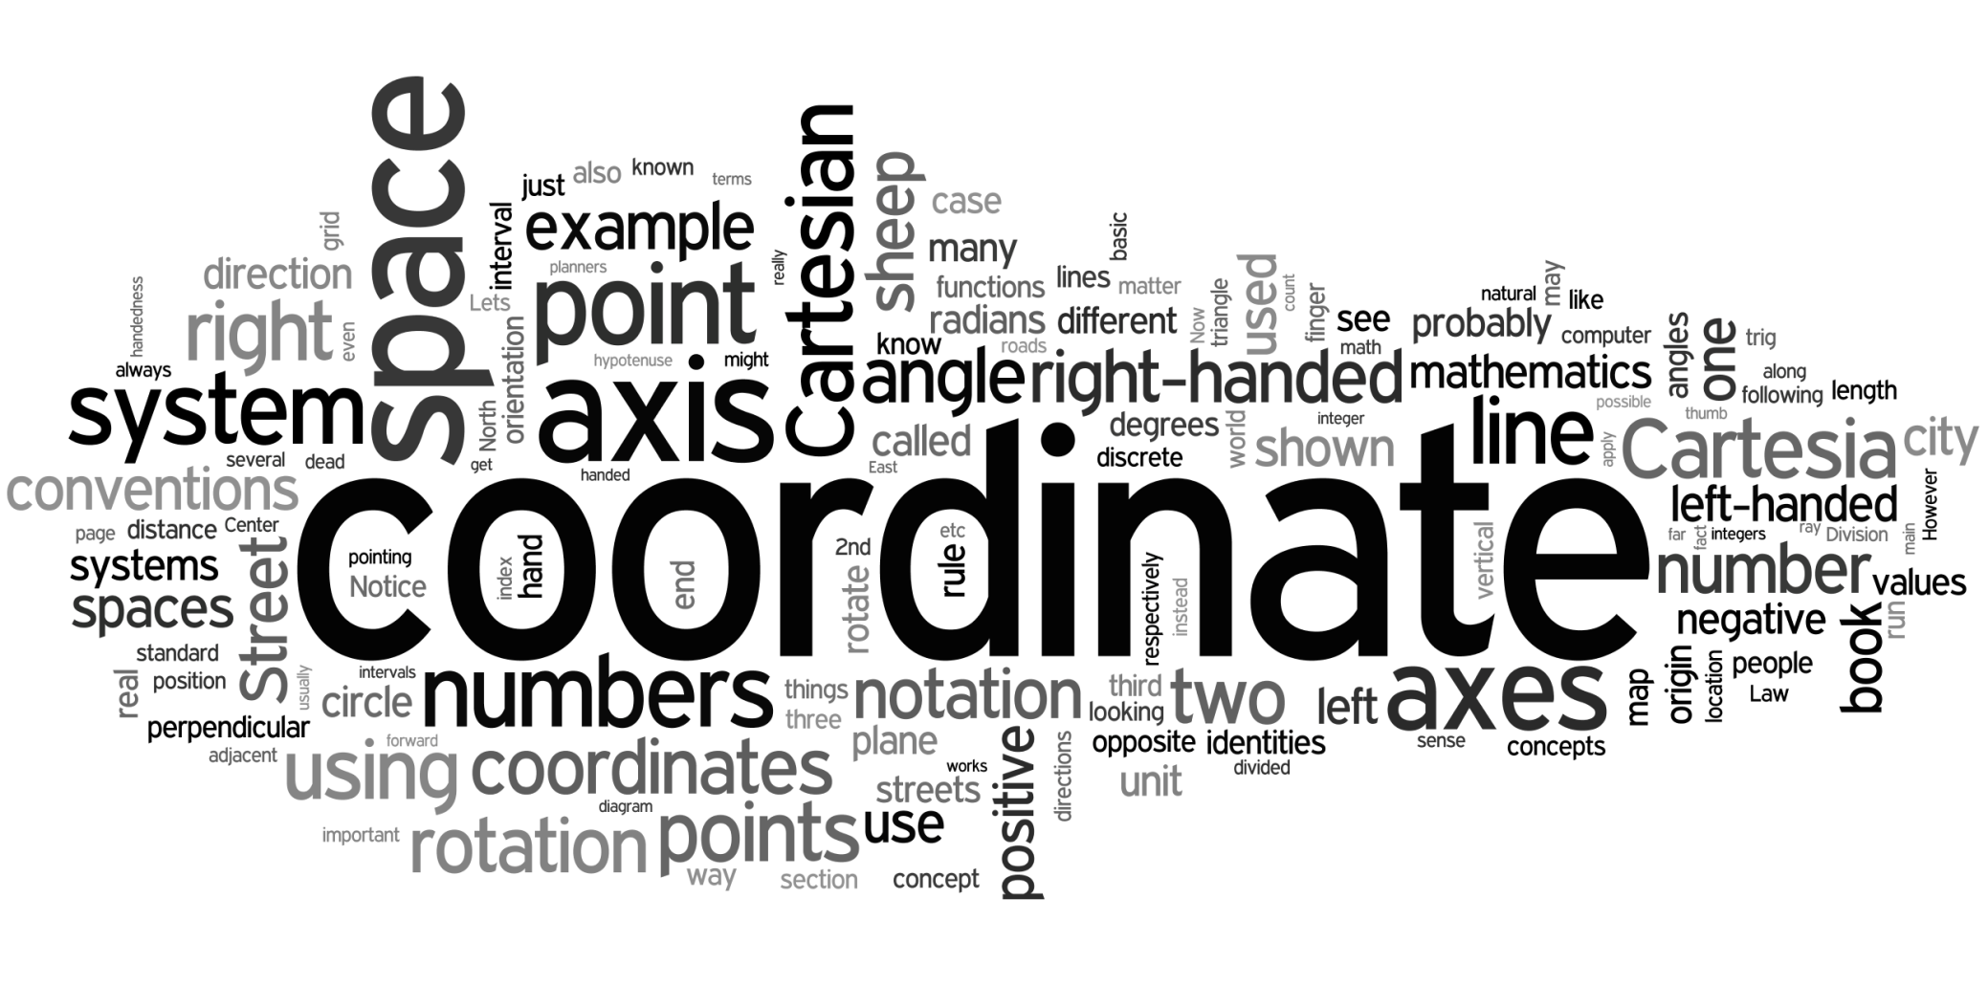
Word Cloud

Slide 4
Introduction and Section 1.1: 1D Mathematics

Slide 5
Introduction
3D math is all about measuring locations, distances, and angles precisely and mathematically in 3D space.
The most frequently used framework to perform such calculations using a computer is called the Cartesian coordinate system.

Slide 6
René Descartes
Cartesian mathematics was invented by (and is named after) French philosopher, physicist, physiologist, and mathematician René Descartes, 1596 - 1650.
Descartes is famous not just for inventing Cartesian mathematics, which at the time was a stunning unification of algebra and geometry. He is also well-known for making a pretty good stab of answering the question “How do I know something is true?”, a question that has kept generations of philosophers happily employed.

Slide 7

René Descartes, 1596 - 1650
(After Frans Hals, Portrait of René Descartes, from Wikimedia Commons.)

Slide 8
1D Mathematics
We assume that you already know about the natural numbers, the integers, the rational numbers, and the real numbers.
On a computer you have to make do with shorts, ints, floats, and doubles. These have limited precision.
We assume that you have a basic understanding about how numbers are represented on a computer.
Remember the First Law of Computer Graphics: If it looks right, it is right.

Slide 9
Section 1.2: 2D Cartesian Space

Slide 10
The City of Cartesia
As you can see from the map on the next slide, Center Street runs east-west through the middle of town.
All other east-west streets are named based on whether they are north or south of Center Street, and how far away they are from Center Street. Examples of streets which run east-west are North 3rd Street and South 15th Street.
The other streets in Cartesia run north-south. Division Street runs north-south through the middle of town.
All other north-south streets are named based on whether they are east or west of Division street, and how far away they are from Division Street. So we have streets such as East 5th Street and West 22nd Street.

Slide 11
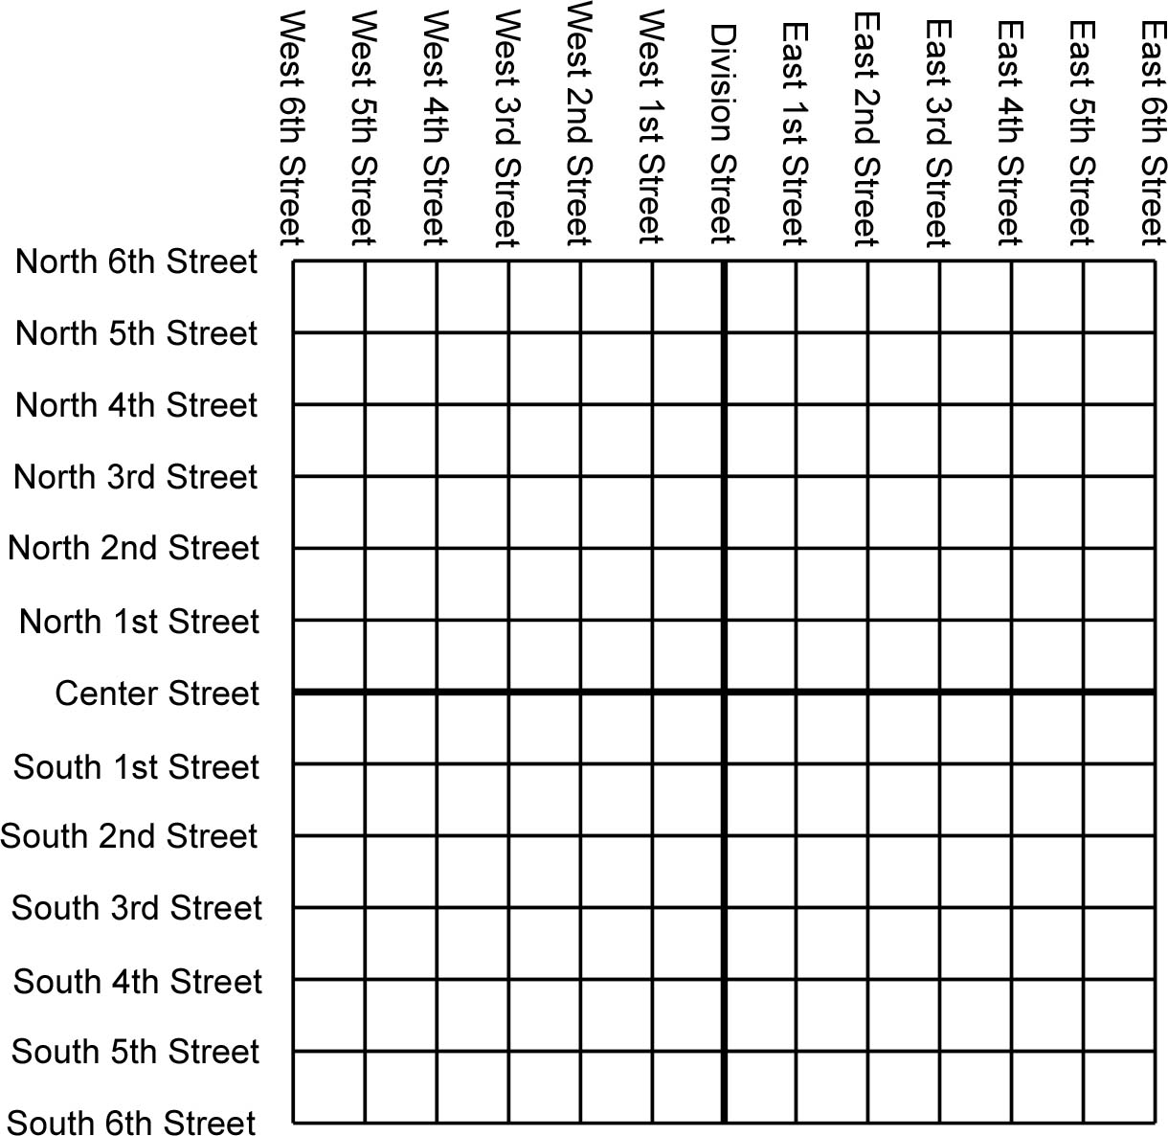

Slide 12
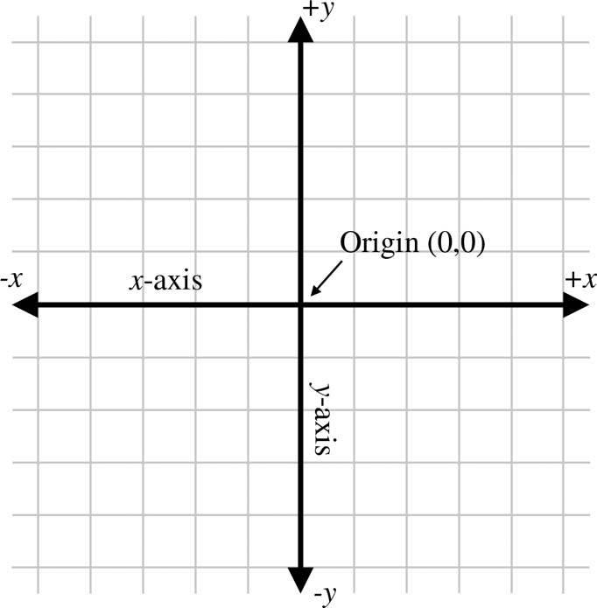
2D Coordinate Spaces
All that really matters are the numbers.
The abstract version of this is called a 2D Cartesian coordinate space.

Slide 13
Origin and Axes
Every 2D Cartesian coordinate space has a special location, called the origin, which is the center of the coordinate system. The origin is analogous to the center of the city in Cartesia.
Every 2D Cartesian coordinate space has two straight lines that pass through the origin. Each line is known as an axis and extends infinitely in both directions.
The two axes are perpendicular to each other. (Caveat: They don't have to be, but most of the coordinate systems we will look at will have perpendicular axes.)

Slide 14
Axes
In the figure on the previous slide, the horizontal axis is called the x-axis, with positive x pointing to the right, and the vertical axis is the y-axis, with positive y pointing up.
This is the customary orientation for the axes in a diagram.

Slide 15
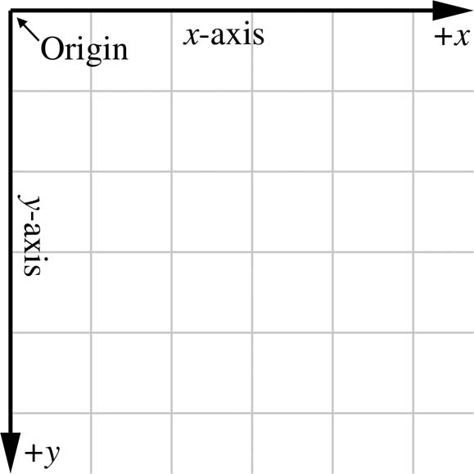
Screen Space
But it doesn’t have to be this way. It’s only a convention.
In screen space, for example, +y points down.
Screen space is how you measure on a computer screen, with the origin at the top left corner.

Slide 16
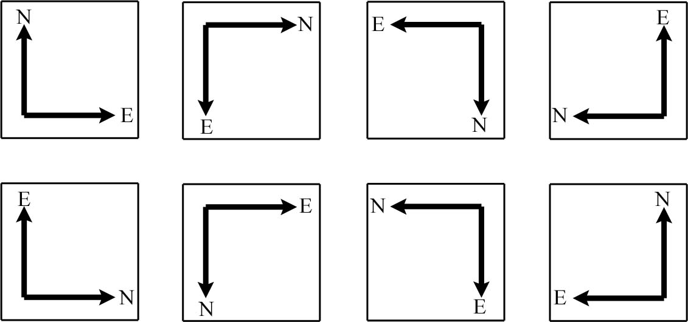
Axis Orientation
There are 8 possible ways of orienting the Cartesian axes.

Slide 17
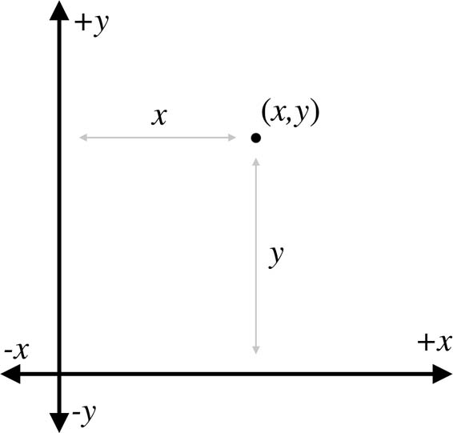
Locating Points in 2D
Point (x,y) is located x units across and y units up from the origin.

Slide 18
Axis Equivalence in 2D
These 8 alternatives can be obtained by rotating the map around 2 axes (any 2 will do).
Surprisingly, this is not true of 3D coordinate space, as we will see later.

Slide 19
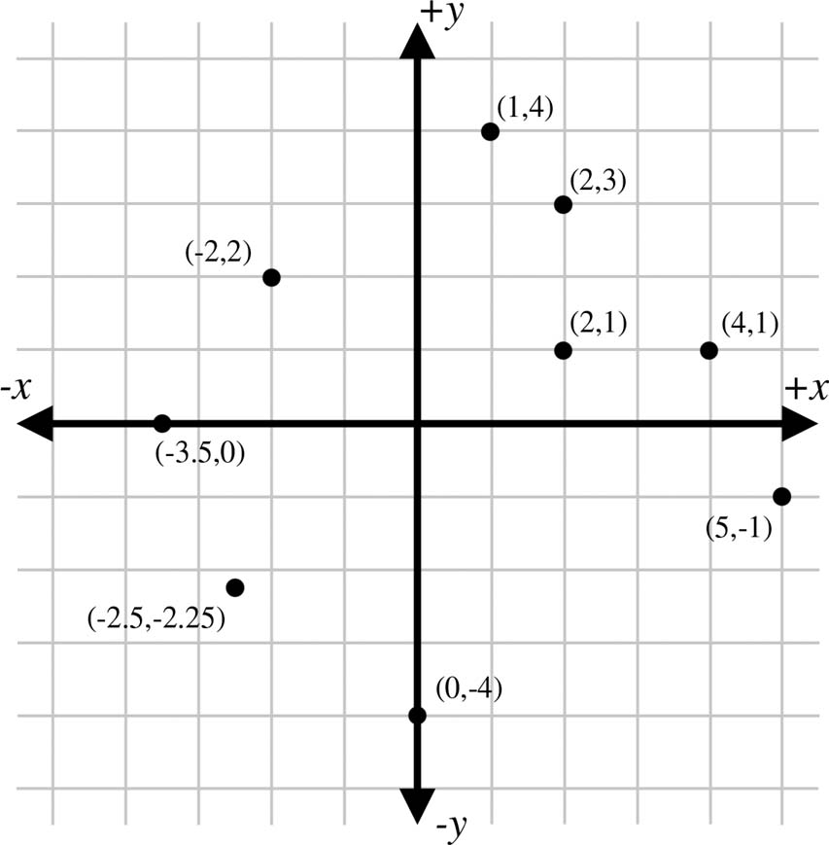
Examples

Slide 20
Section 1.3: 3D Cartesian Space

Slide 21
3D Cartesian Space

Slide 22
Locating Points in 3D
Point (x,y,z) is located x units along the x-axis, y units along the y-axis, and z units along the z-axis from the origin.

Slide 23
Axis Equivalence in 3D
Recall that in 2D the alternatives for axis orientation can be obtained by rotating the map around 2 axes.
As we said, this is not true of 3D coordinate space.

Slide 24
Visualizing 3D Space
The usual convention is that the x-axis is horizontal and positive is right, and that the y-axis is vertical and positive is up
The z-axis is depth, but should the positive direction go forwards “into” the screen or backwards “out from” the screen?

Slide 25
Left-handed Coordinates
+z goes “into” screen
Use your left hand
Thumb is +x
Index finger is +y
Second finger is +z

Slide 26
Right-handed Coordinates
+ z goes “out from” screen
Use your right hand
Thumb is +x
Index finger is +y
Second finger is +z
(Same fingers, different hand)

Slide 27
Changing Conventions
To swap between left and right-handed coordinate systems, negate the z.
Graphics books usually use left-handed.
Linear algebra books usually use right-handed.
We’ll use left-handed.

Slide 28
Positive Rotation
Use your left hand for a left-handed coordinate space, and your right hand for a right-handed coordinate space.
Point your thumb in the positive direction of the axis of rotation (which may not be one of the principal axes).
Your fingers curl in the direction of positive rotation.

Slide 29
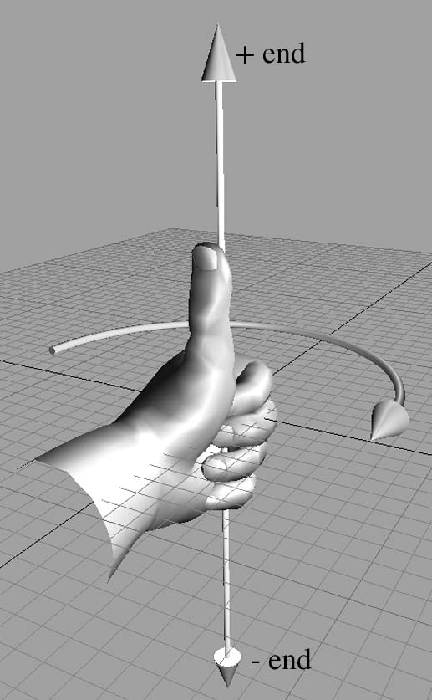
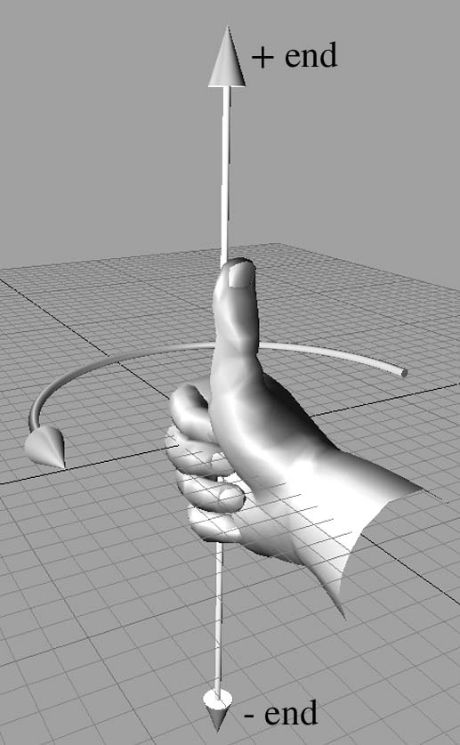
Positive Rotation

Slide 30
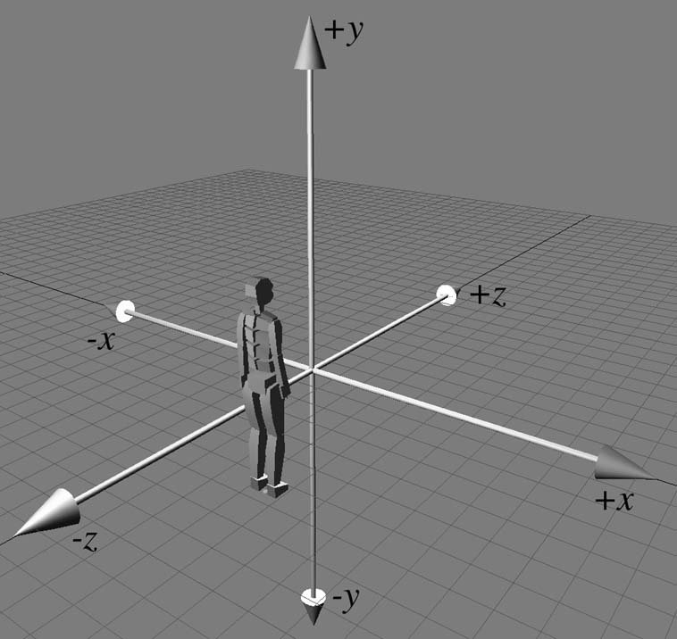
Our Convention
For the remainder of these lecture notes, as in the book, we will use a left-handed coordinate system.

Slide 31
Section 1.4: Odds and Ends

Slide 32


Odds and Ends of Math Used
Summation and product notation:

Slide 33
Angles
An angle measures an amount of rotation in the plane.
Variables for angles are often given the Greek letter θ.
The most important units of measure are degrees (°) and radians (rad).
Humans usually measure angles using degrees.
One degree measures 1/360th of a revolution, so 360° is a complete revolution.
Mathematicians, prefer to measure angles in radians, which is a unit of measure based on the properties of a circle.
When we specify the angle between two rays in radians, we are actually measuring the length of the intercepted arc of a unit circle, as shown in the figure on the next slide.

Slide 34
θ Radians

Slide 35
Radians and Degrees
The circumference of a unit circle is 2π radians, with π approximately equal to 3.14159265359.
Therefore, 2π radians represents a complete revolution.
Since 360° = 2π rad, 180° = π rad.
To convert an angle from radians to degrees, we multiply by 180/π ≈ 57.29578 and to convert an angle from degrees to radians, we multiply by π/180 ≈ 0.01745329.

Slide 36
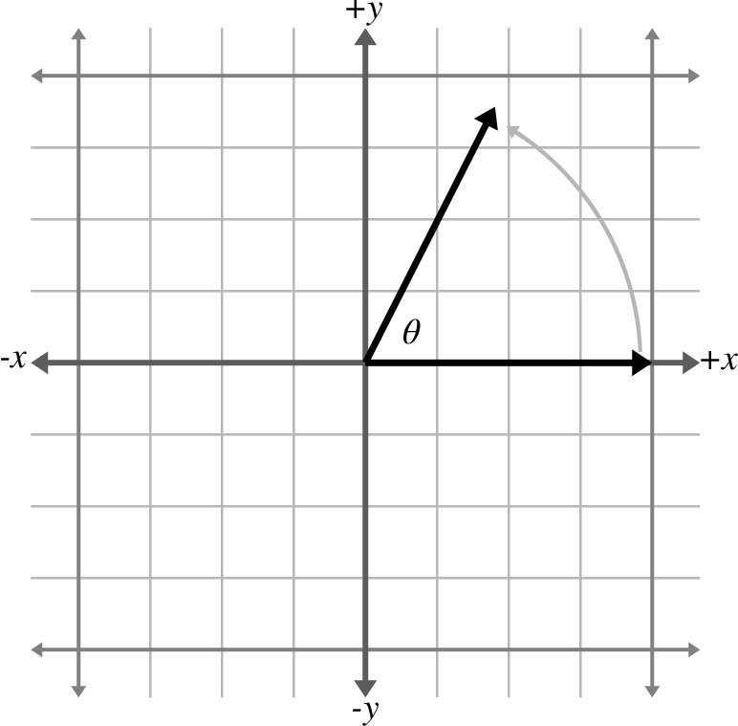
Trig Functions
Consider the angle θ between the +x axis and a ray to the point (x,y) in this diagram.

Slide 37
Cosine & Sine
The values of x and y, the coordinates of the endpoint of the ray, have special properties, and are so significant mathematically that they have been assigned special functions, known as the cosine and sine of the angle.
cos θ = x
sin θ = y
You can easily remember which is which because they are in alphabetical order: x comes before y, and cos comes before sin.

Slide 38
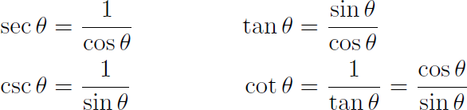
More Trig Functions
The secant, cosecant, tangent, and cotangent.

Slide 39
Back to Sine and Cos
If we form a right triangle using the rotated ray as the hypotenuse, we see that x and y give the lengths of the adjacent and opposite legs of the triangle, respectively.
The terms adjacent and opposite are relative to the angle θ.
Alphabetical order is again a useful memory aid: adjacent and opposite are in the same order as the corresponding cosine and sine.
Let the variables hypotenuse, adjacent, and opposite stand for the lengths of the hypotenuse, adjacent leg, and opposite leg, respectively, as shown on the next slide.

Slide 41
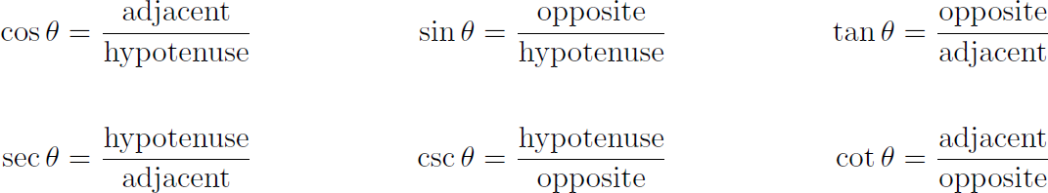
Primary Trig Functions

Slide 42
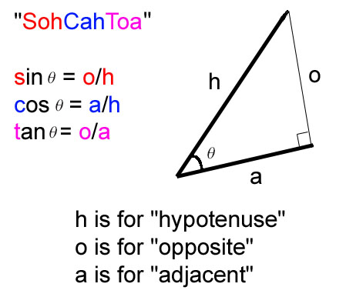
Mnemonics for Trig Functions

Slide 43
Alternative Forms
Some old horse
Caught another horse
Taking oats away
Some old hippy
Caught another hippy
Tripping on acid

Slide 44
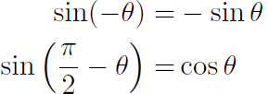
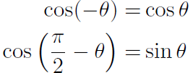
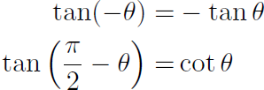
Identities Related to Symmetry

Slide 45
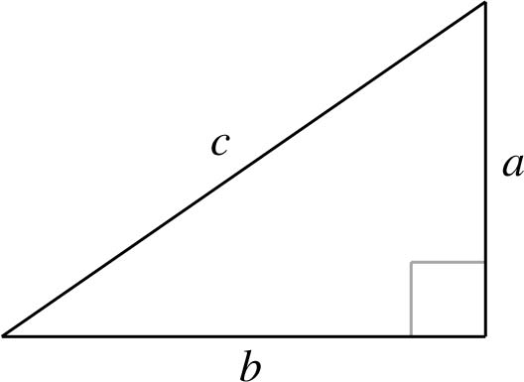
The Pythagorean Theorem
The sum of the squares of the two legs of a right triangle (those sides that are adjacent to the right angle) is equal to the square of the hypotenuse (the leg opposite the right angle). That is, a² + b² = c².

Slide 46
Pythagorean Identities
These identities can be derived by applying the Pythagorean theorem to the unit circle.
sin² θ + cos² θ = 1
1 + tan² θ = sec² θ
1 + cot² θ = csc² θ

Slide 47
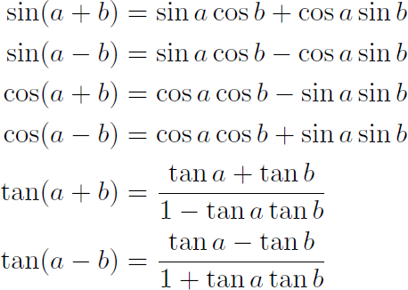
Sum & Difference Identities

Slide 48
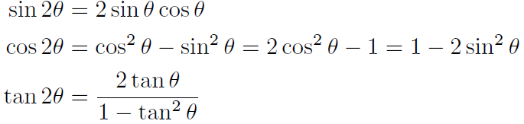
Double Angle Identities
If we apply the sum identities to the special case where a and b are the same, we get the following double angle identities.

Slide 49
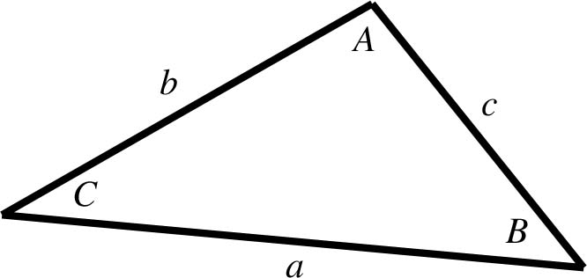

Law of Sines

Slide 50
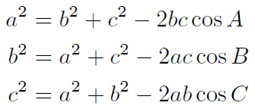
Law of Cosines

Slide 51
That concludes Chapter 1. Next, Chapter 2: Vectors

